Slide 1
Encrypt All The Things:
Implementing App Mobile Security
Nathan Freitas @n8fr8 @guardianproject
https://guardianproject.info

Slide 2
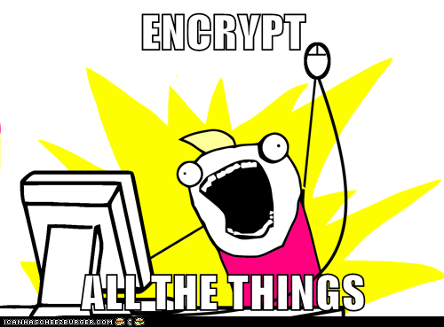
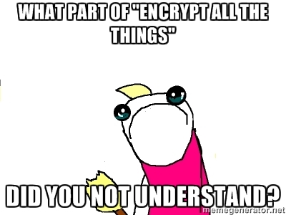
INTENTION
vs.
EXECUTION

Slide 3

The Guardian Project
https://guardianproject.info
Secure Your Mobile Life Apps & Tools You Can Trust
The Guardian Project creates easy-to-use open source apps, mobile OS security enhancements, and customized mobile devices for people around the world to help them communicate more freely, and protect themselves from intrusion and monitoring.

Slide 4
Session Overview
Overview of Guardian Project Apps & Developer Libraries (30m)
Threat Models and War Stories: Open Discussion about Risks, Fears and Security Needs (30m)
Encrypted Databases: securing structured data in activities, services and content providers (1hr)
Encrypted Files: securing arbitrary files from small to large (30m)
Secured Networking: defending against man-in-the-middle, SSL stripping, filtering and more (30m)
Hands-On Implementation time for sample work or debugging your own apps with new security features (1.5hr)

Slide 5
Encryption
a *very* quick introduction

Slide 6
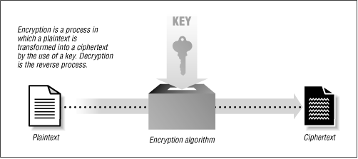

What is Encryption?
Plaintext + Algorithm + Key =Ciphertext
Symmetric vs Asymmetric, Private vs Public
Randomness:
Actual vs Pseudo
Common Cryptography Tools: OpenSSL, PGP (GnuPG!), BouncyCastle

Slide 7
Android Built-in Encryption
HTTPS / TLS / SSL
javax.crypto “BouncyCastle”
OpenSSL
Full Disk Encryption
Android KeyChain ( > API 18)

Slide 8
CipherKit
https://guardianproject.info/code

Slide 9
CipherKit “Platform”
YOUR APP HERE!
Cache
Word
SQLCipher
IOCipher
NetCipher
java.io.File
Android HTTP,
java.net.*
Orbot: Tor for Android
OpenSSL
SQLite android.database.*

Slide 10
“CipherKit” Dev Libraries
CipherKit is designed for Android app developers to make apps that are able to ensure better privacy, security and anonymity
SQLCipher: Encrypted Database
SQLCipher is an SQLite extension that provides transparent 256-bit AES encryption of database files. It mirrors the standard android.database API. Pages are encrypted before being written to disk and are decrypted when read back.
IOCipher: Encrypted Virtual Disk
IOCipher is a virtual encrypted disk for apps without requiring the device to be rooted. It uses a clone of the standard java.io API for working with files. Just password handling & opening the virtual disk are what stand between developers and fully encrypted file storage. It is based on libsqlfs and SQLCipher.
NetCipher: Encrypted Network Data & Tor Integration
NetCipher is improving network security. It provides a strong TLS/SSL verifier to help mitigate weaknesses in the certificate authority system. It eases the implementation of supporting SOCKS and HTTP proxies into applications and also supports onion routing for anonymity and traffic surveillance circumvention.

Slide 11
Let’s take a step back...
(to figure out what it is we are worried about)

Slide 12
Basic Threat Modeling
“What are you worried about?” aka Possible Attack Vectors
What data are you collecting or services are you providing that might be enticing or exposed?
Are the potential threats you face coming from the device (other apps or physical access) or the network?

Slide 13
War Stories?
Have your apps, your business or your users or customers lives or businesses been affected by malware or security breaches?
Do you work in an industry that has specific requirements related to security and privacy?
Do you target a region of the world where users might be more exposed to attack, surveillance or privacy violations?

Slide 14
Threat Landscape
Forensic Analysis
Rooting / Jail breaking
OS Issues
Infrequent Updates
Removable Storage
Cloud Services
Targeted Attacks
Device Sharing

Slide 15

Malware on the rise: http://blog.trendmicro.com/trendlabs-security-intelligence/mobile-malware-high-risk-apps-hit-1m-mark/

Slide 16
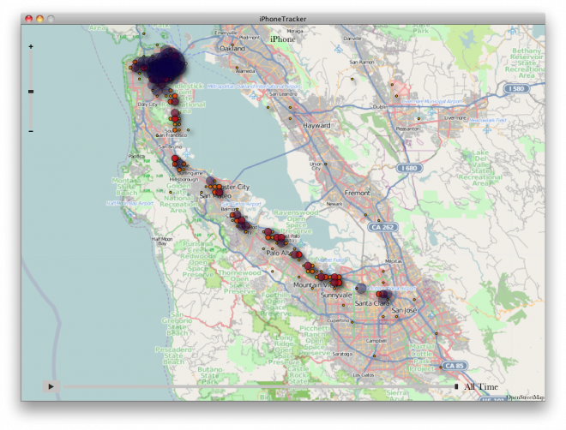
Cached GPS data stored in plain text http://elifelog.org/book/iphone-gps-cache-data

Slide 17
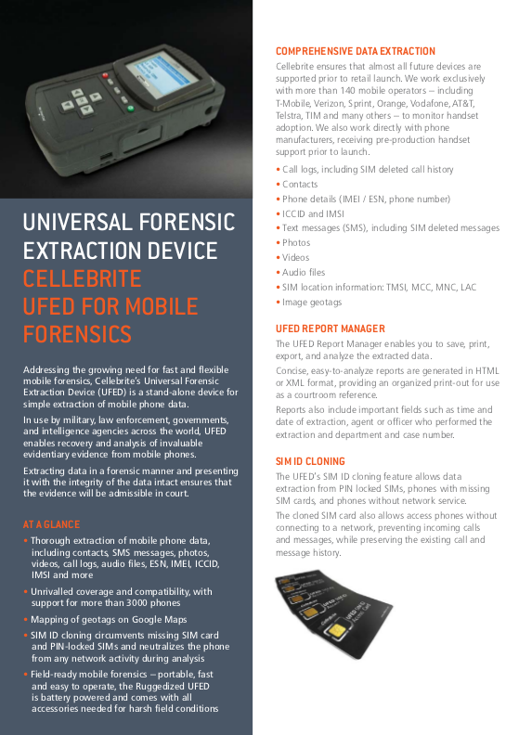
"Universal Forensic Extraction Devices" can quickly and easily copy all of the data from a mobile phone.
If tools like these fall into the wrong hands, it is easy to assume any unencrypted data on a device can be easily stolen.
Forensic Extraction http://www.cellebrite.com/mobile-forensics

Slide 18
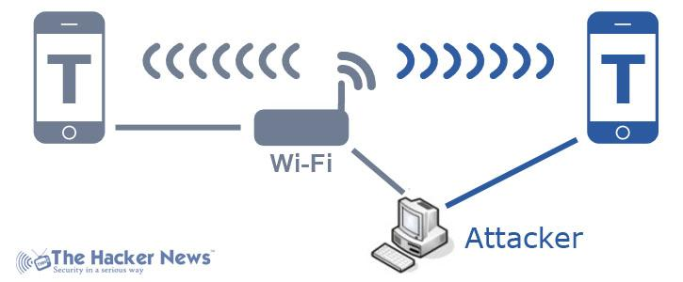
Man-in-the-Middle: http://thehackernews.com/2013/03/t-mobile-wi-fi-calling-app-vulnerable.html

Slide 19

Trust Levels
ID | Name | Description
1 | Owner of the mobile phone | The primary operator of the mobile device. Assumed to have full access to the device, potentially secured with a PIN/password screen.
2 | Detainer / criminal / bad actor | An authority figure or criminal who has or will be detaining the Owner[1]; has access to mobile phone. may have only manual/brute force access, or could have more sophisticated forensic extraction tools.
3 | Operator of the mobile network | Access to call and message logs (sender/receiver/message content) and cell tower association data (rough location)
4 | Employer, family or support organization; | May know the Owner[1]'s PIN/password, but otherwise has no access to data or network information; On the receiving end of an emergency message
5 | Malicious App / Backdoor / Malware / Forensics App | Access to some or all of the the Owner[1]'s data depending upon app data permissions and encryption, as well as how full the backdoor is. Authorization is often required by the user to allow apps to access data.

Slide 20
Assets
ID | Name | Description | Trust Level
1 | Personal data | Names, emails, phone numbers, calendar events, mostly stored on internal device memory | [1] Owner [5] Malicious App (as authorized)
2 | Communication data | Text messages, emails, call logs, mostly stored on internal device memory | [1] Owner [3] Operator [5] Malicious App (as authorized)
3 | Application data | Custom data stored by browsers, chat, social networking apps, on both internal and memory card; | [1] Owner [3] Operator (if not HTTP/S or SSL) [5] Malicious App (as authorized)
4 | Media files | User generated and download photos, videos and music, primarily stored on memory card | [1] Owner [5] Malicious App

Slide 21
STRIDE Threat List
Type | Examples
Spoofing | - Detainer[2] or Malicious App[5] may gain control of mobile phone and pretend to be Owner[1]
Tampering | - Malicious App[5] changes configuration data on the device
Repudiation | - Malicious App[5] or other system backdoor may disable or block app - Operator[3] may passively monitor messages and pass the information along to the Detainer[2]
Information Disclosure | Detainer[2] could have full access to Assets stored on the mobile device - Detainer[2] may have physical and logical forensic data extraction tools that can override password controls on device and read from "wiped" storage - Operator[3] may learn identity of Support Org[4]
Denial of Service | - Communications may be blocked from being sent or received by Operator [3] - Mobile phone may be disabled by Operator[3] or Malicious App[5] from running remote wipe
Elevation of Privilege | - Malicious App [5] launches insecured intents or exploits known bug - Detainer[2] or Operator[3] may be able to impersonate the Owner[1]

Slide 22
Security Controls / Mitigation
Type | Tactics
Authentication (vs. Spoofing) | - Create a a non obvious passphrase for use in app - Lock screen of your mobile phone using passphrase or PIN
Authorization & Auditing (vs Tampering, Repudiation, Elevation of Priv) | - Do not install any unnecessary, third-party mobile apps with network access - Scan your mobile device using available malware tools - Install a firewall or network connection monitoring utility - Use a non-real name registered SIM card and mobile phone
Cryptography and Identity Protection (vs Information Disclosure) | - For extra sensitive data, use an app that supports an and password authentication and encrypted database - Use a mobile OS with disk and memory card encryption - Use only browser-based HTTPS services that do not store data locally - Do not store or save web service passwords on your mobile phone
Alternate Communications (vs Denial of Service) | - Use VPNs or Tor proxying software to hide source IP and traffic - Use apps/services that work in WIFI only mode if data service disabled - Use apps that allow device-to-device data sharing

Slide 23
SQLCipher
Encrypted Database

Slide 24
SQLCipher: Encrypted DB
SQLCipher is an SQLite extension that provides transparent 256-bit AES encryption of database files. It mirrors the standard android.database API. Pages are encrypted before being written to disk and are decrypted when read back.
SQLCipher has a small footprint and great performance so it’s ideal for protecting embedded application databases and is well suited for mobile development.
Blazing fast performance with as little as 5-15% overhead for encryption
100% of data in the database file is encrypted
Uses good security practices (CBC mode, key derivation)
Zero-configuration and application level cryptography
Algorithms provided by the peer reviewed OpenSSL crypto library.

Slide 25
CipherKit “Platform”
YOUR APP HERE!
SQLCipher
Cache
Word
IOCipher
NetCipher
java.io.File
Android HTTP,
java.net.*
Orbot: Tor for Android
OpenSSL
SQLite android.database.*

Slide 26
Defense in Depth
Make attacks difficult with multiple layers of security
Notes:
Goals for risk mitigation at the application level.
The first key is layered security.
It’s OK to use the device security as a first gateway
Applications should consider whether they need their own security implementation
The more layers you can put between a potential attacker and your data, the better

Slide 27
Principle of
Least Privilege
Access to device should not allow access to all apps and data
Notes:
Reduce attack “surface area”
Don’t assume for a second that the owner if the device is going to be the only person using it.
If your application deals with sensitive data it should provide a security “Step Up”
Even a minimal block to ensure that a casual user can’t open the app and poke around

Slide 28
Data Security
Minimize impact of unauthorized access, on and off device
Notes:
Simple authentication or local auth to keep casual users out
But, don’t trust that the app is the only way to get the data on or off device
Data can be extracted off devices
Off backups
Device can be lost and compromised
Using a cloud service (Dropbox, Google Drive, iCloud), can you control all of the access points?
Vectors for replacing / compromising databases

Slide 29
Strategies
Authentication
Encryption
Authenticity
Notes:
Authentication - verify that the user of the application knows some unique secret to access the data
Encryption
Ensure that the data is unreadable without the secret
Even if extracted off the device
pulled off a cloud service
pulled from a backup on SD card, etc
Authenticity
Ensure that if the data can’t be tampered with
Options
Don’t do anything locally
Usability, performance, offline
File level encryption
Field level encryption
A lot of work

Slide 30
~ sjlombardo$ hexdump -C sqlite.db
00000000 53 51 4c 69 74 65 20 66 6f 72 6d 61 74 20 33 00 |SQLite format 3.|
…
000003c0 65 74 32 74 32 03 43 52 45 41 54 45 20 54 41 42 |et2t2.CREATE TAB|
000003d0 4c 45 20 74 32 28 61 2c 62 29 24 01 06 17 11 11 |LE t2(a,b)$…..|
…
000007e0 20 74 68 65 20 73 68 6f 77 15 01 03 01 2f 01 6f | the show…./.o|
000007f0 6e 65 20 66 6f 72 20 74 68 65 20 6d 6f 6e 65 79 |ne for the money|
~ $ sqlite3 sqlcipher.db
sqlite> PRAGMA KEY=’test123′;
sqlite> CREATE TABLE t1(a,b);
sqlite> INSERT INTO t1(a,b) VALUES (‘one for the money’, ‘two for the show’);
sqlite> .quit
~ $ hexdump -C sqlite.db
00000000 84 d1 36 18 eb b5 82 90 c4 70 0d ee 43 cb 61 87 |.?6.?..?p.?C?a.|
00000010 91 42 3c cd 55 24 ab c6 c4 1d c6 67 b4 e3 96 bb |.B?..?|
00000bf0 8e 99 ee 28 23 43 ab a4 97 cd 63 42 8a 8e 7c c6 |..?(#C??.?cB..|?|
~ $ sqlite3 sqlcipher.db
sqlite> SELECT * FROM t1;
Error: file is encrypted or is not a database
SQLite vs. SQLCipher

Slide 31
import net.sqlcipher.database.SQLiteDatabase;
SQLiteDatabase.loadLibs(this);
SQLiteDatabase db = eventsData.getWritableDatabase(“mypassword”);
https://github.com/sqlcipher/android-database-sqlcipher

Slide 32
Simple Steps
We’ve packaged up a very simple SDK for any Android developer to add SQLCipher into their app with the following three steps:
Add a single sqlcipher.jar and a few .so’s to the application libs directory
Update the import path from android.database.sqlite.* toinfo.guardianproject.database.sqlite.* in any source files that reference it. The original android.database.Cursor can still be used unchanged.
Init the database in onCreate() and pass a variable argument to the open database method with a password*:
SQLiteDatabase.loadLibs(this); //first init the db libraries with the context
SQLiteOpenHelper.getWritableDatabase(“thisismysecret”):

Slide 33
Features
AES 256 CBC
Random IVs
Random salt
Key Derivation
MAC
OpenSSL
Fast startup
No size limit
Notes:
AES 256 CBC
Random IVs
Random salt
PBKDF2
MAC
OpenSSL
Fast startup
No size limit

Slide 34
How it Works
Database Salt
Encrypted Data
Page
1
Pager Codec
Key Derivation
Encryption
MAC
Encrypted Data
IV
MAC
Encrypted Data
Page
2
Encrypted Data
IV
MAC
Encrypted Data
Page
3
Encrypted Data
IV
MAC
Notes:
Pager Codec
Key Derivation
Encryption
MAC

Slide 35
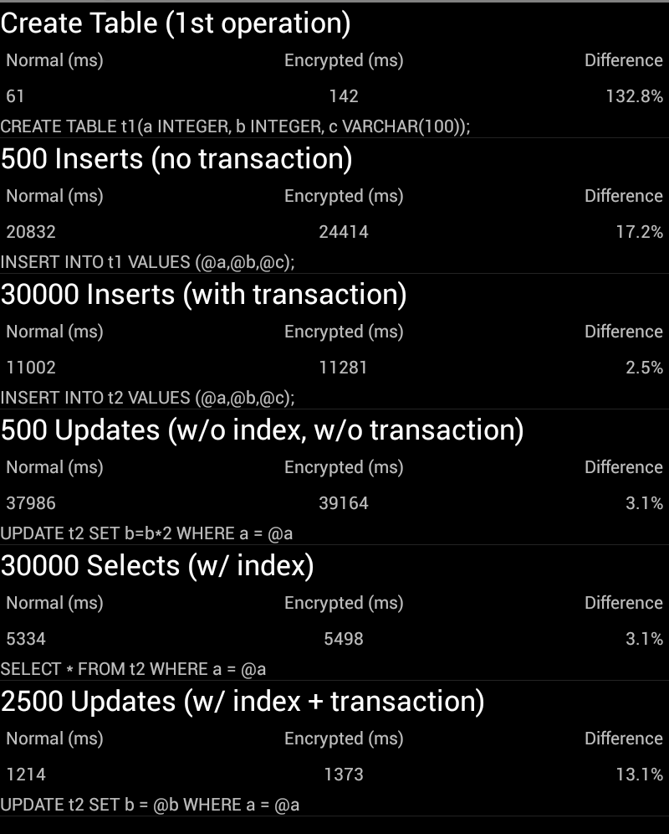
Performance
Notes:
Performance on the overall is very good
Encryption overhead is minimal ranging from 5 – 35% in most cases, more in some exceptional situations
Design is important
Do - Normalize data
Do - Use indexes
Do – Use Transactions
Don’t - frequent non-indexed queries or massive updates
Don’t - open new connections for every database

Slide 36
Advanced
PRAGMA rekey
PRAGMA cipher
PRAGMA kdf_iter
PRAGMA cipher_page_size
PRAGMA cipher_use_hmac
ATTACH
sqlcipher_export()
Notes:
PRAGMA rekey
PRAGMA cipher
PRAGMA kdf_iter
PRAGMA cipher_page_size
PRAGMA cipher_use_hmac
ATTACH
sqlcipher_export()

Slide 37
IOCipher
Encrypted Virtual File System

Slide 38
IOCipher: Encrypted Files
IOCipher provides a virtual encrypted disk for Android apps without requiring the device to be rooted. It uses a clone of the standard java.io API for working with files, so developers already know how to use it. Only password handling, and opening the virtual disk are what stand between the developer and working encrypted file storage. It is based on and SQLCipher.
IOCipher is a cousin to SQLCipher-for-Android since it is also based on SQLCipher and uses the same approach of repurposing an API that developers already know well. It is built on top of libsqlfs, a filesystem implemented in SQL that exposes a FUSE API.

Slide 39
CipherKit “Platform”
YOUR APP HERE!
Cache
Word
SQLCipher
IOCipher
NetCipher
java.io.File
Android HTTP,
java.net.*
Orbot: Tor for Android
OpenSSL
SQLite android.database.*

Slide 40
IOCipher: Core Features
Secure transparent app-level virtual encrypted disk
No root required
Only three new methods to learn: new VirtualFileSystem(dbFile), VirtualFileSystem.mount(password), and VirtualFileSystem.unmount()
Supports Android versions 2.1 and above
Licensed under the LGPL v3+

Slide 41
IOCipher: The Stack
info.guardianproject.iocipher
Java/JNI wrapper API
LibSQLFS / FUSE
Virtual Filesystem that maps to SQL schema / structured database
SQLCipher
Encryption layer for SQLite
SQLite
Base storage mechanism

Slide 42
Adding IOCipher to App
manage the password
connect to your encrypted disk’s file using new VirtualFileSystem(dbFile)
mount it with a password using VirtualFileSystem.mount(password)
replace the relevant java.io import statements withinfo.guardianproject.iocipher, e.g.:
import info.guardianproject.iocipher.File;
import info.guardianproject.iocipher.FileOutputStream;
import info.guardianproject.iocipher.FileReader;
import info.guardianproject.iocipher.IOCipherFileChannel;
import info.guardianproject.iocipher.VirtualFileSystem;
import java.io.FileNotFoundException;
import java.io.IOException;
import java.io.InputStream;
import java.nio.channels.Channels;
import java.nio.channels.ReadableByteChannel;

Slide 43
import info.guardianproject.iocipher.File;
import info.guardianproject.iocipher.FileOutputStream;
import info.guardianproject.iocipher.VirtualFileSystem;
File dbFile = getDir("vfs", MODE_PRIVATE).getAbsolutePath() + "/myfiles.db";
vfs = new VirtualFileSystem(dbFile);
// TODO don't use a hard-coded password! prompt for the password
vfs.mount("my fake password");
File file = new File(dirPath);
File[] files = file.listFiles();
https://github.com/guardianproject/IOCipherExample

Slide 44
CacheWord
Secure Passphrase Management

Slide 45
CacheWord
CacheWord is an Android library project for passphrase caching and management. It helps app developers securely generate, store, and access secrets derived from a user's passphrase.
Secrets Management: how the secret key material for your app is generated, stored, and accessed
Passphrase Caching: store the passphrase in memory to avoid constantly prompting the user

Slide 46
CipherKit “Platform”
YOUR APP HERE!
Cache
Word
SQLCipher
IOCipher
NetCipher
java.io.File
Android HTTP,
java.net.*
Orbot: Tor for Android
OpenSSL
SQLite android.database.*

Slide 47
CacheWord Features
CacheWord manages key derivation, verification, persistence, passphrase resetting, and caching secret key material in memory.
Strong key derivation (PBKDF2)
Secure secret storage (AES-256 GCM)
Persistent notification: informs the user the app data is unlocked
Configurable timeout: after a specified time of inactivity the app locks itself
Manual clearing: the user can forcibly lock the application
Uses Android's Keystore on 4.x if available - Not Yet Implemented

Slide 48
The Problem with Android...
Activity
Activity
onCreate()
- prompt user for passwd
- unlock SQLCipher
onDestroy()
- close DB instance
- lose cached password
onCreate()
- prompt user for passwd AGAIN! (annoying)
SQLCipher DB
(Activity, Service and even App lifespan is unpredictable)

Slide 49
Cacheword Solution
Activity
Activity
onCreate()
- prompt user for passwd
- store in CacheWord
onDestroy()
- close DB instance (but keep cacheword alive!)
onCreate()
- re-open DB instance via cached passphrase in CacheWord
SQLCipher DB
Cacheword (long running, foreground, minimal memory service)

Slide 50
public class CacheWordSampleActivity extends Activity implements ICacheWordSubscriber {
…
mCacheWord = new CacheWordActivityHandler(this);
@Override
public void onCacheWordLocked() {}
@Override
public void onCacheWordOpened() {
// fetch the encryption key from CacheWordService
SecretKey key = ((PassphraseSecrets) mCacheWord.getCachedSecrets()).getSecretKey();
}
@Override
public void onCacheWordUninitialized() {
mCacheWord.setCachedSecrets(PassphraseSecrets.initializeSecrets(
CacheWordSampleActivity.this, “my secret passphrase”));
}
https://github.com/guardianproject/cacheword/tree/master/sample

Slide 51
NetCipher
Secured Networking

Slide 52
CipherKit “Platform”
YOUR APP HERE!
Cache
Word
SQLCipher
IOCipher
NetCipher
java.io.File
Android HTTP,
java.net.*
Orbot: Tor for Android
OpenSSL
SQLite android.database.*

Slide 53
NetCipher: 3 reasons
Stronger Sockets: Through support for the right cipher suites, pinning and more, we ensure your encrypted connections are as strong as possible.
Proxied Connection Support: HTTP and SOCKS proxy connection support for HTTP and HTTP/S traffic through specific configuration of the Apache HTTPClient library
OrbotHelper: a utility class to support application integration with Orbot: Tor for Android. Check if its installed, running, etc.

Slide 54
Network Threats
Firewall / Filter
Your App
Your Remote Service
Logging / Man-in-the Middle
Your App

Slide 55
NetCipher: Tor Proxying
Firewall / Filter
Your App
Your Remote Service
Tor Network
Orbot:
Tor for Android
Logging / Man-in-the Middle

Slide 56
OrbotHelper oc = new OrbotHelper(this);
if (!oc.isOrbotInstalled())
oc.promptToInstall(this);
else if (!oc.isOrbotRunning())
oc.requestOrbotStart(this);
StrongHttpsClient httpclient = new StrongHttpsClient(getApplicationContext());
if (pType == null)
httpclient.useProxy(false, null, null, -1);
else if (pType == Proxy.Type.SOCKS)
httpclient.useProxy(true, "SOCKS", proxyHost, proxyPort);
else if (pType == Proxy.Type.HTTP)
httpclient.useProxy(true, ConnRoutePNames.DEFAULT_PROXY, proxyHost, proxyPort);
https://github.com/guardianproject/NetCipher

Slide 57
Hands-On Time!
Work with Samples or Your Own App

Slide 58
Time to encrypt all the things!
YOUR APP HERE!
Cache
Word
SQLCipher
IOCipher
NetCipher
java.io.File
Android HTTP,
java.net.*
Orbot: Tor for Android
OpenSSL
SQLite android.database.*

Slide 59
Questions?
What haven’t we covered?

Slide 60
From here...
https://guardianproject.info/contact
Guardian-Dev and SQLCipher mailing lists
IRC (freenode): #guardianproject
Project Trackers: https://dev.guardianproject.info
support@guardianproject.info

